Slide 1
Getting Started

Slide 2
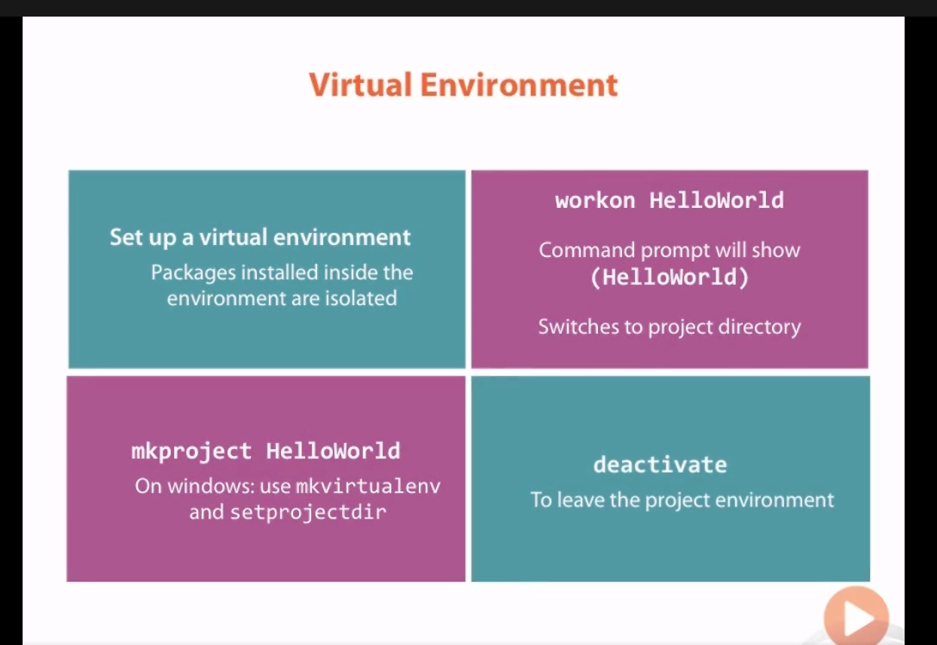

Slide 3
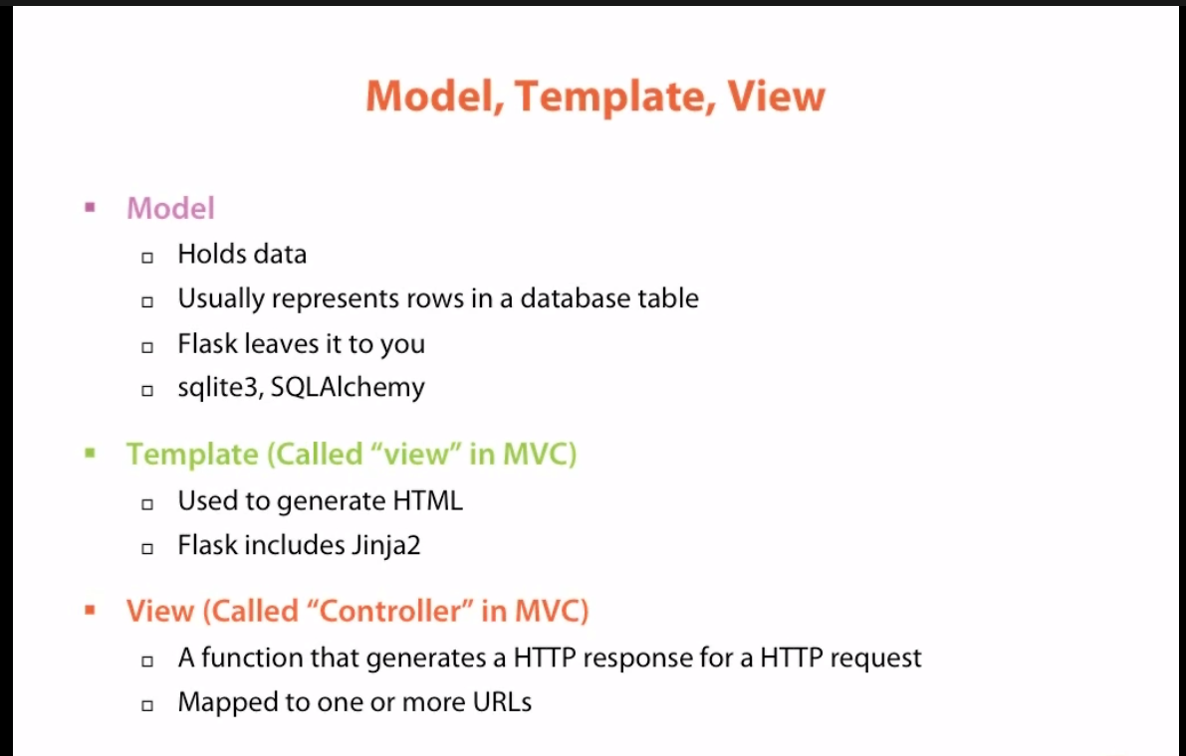
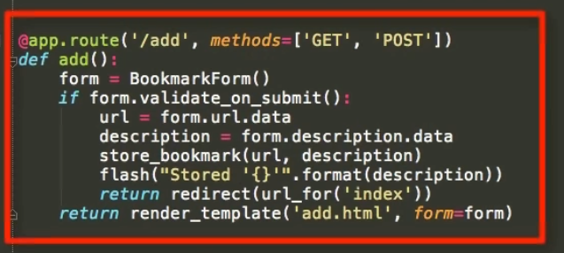
A python function that generates an http response for an http request

Slide 4
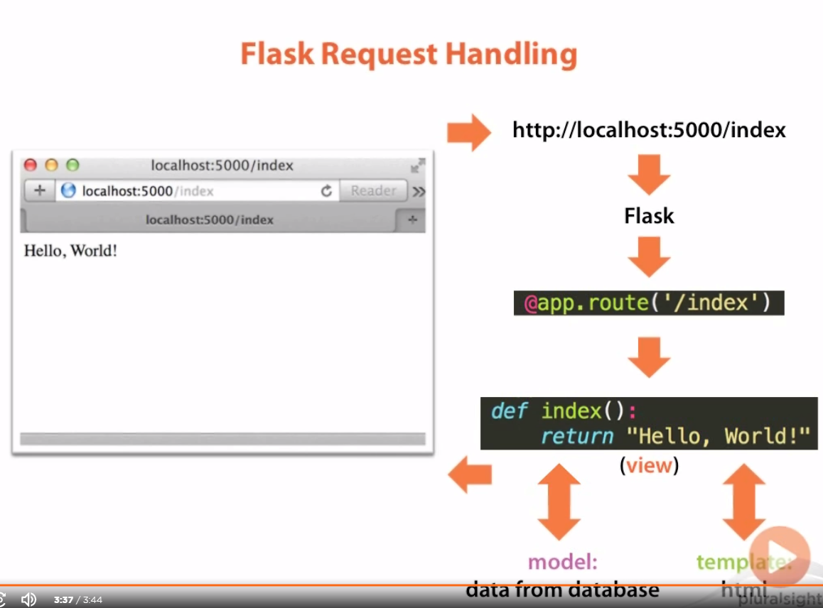

Slide 5
Basic Templates and Views
Module 3

Slide 6
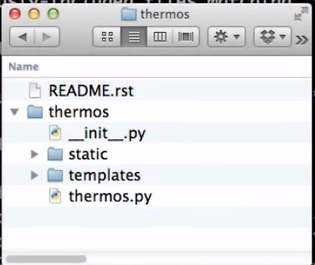
See installingSteps.txt file on how to set virtualenv
File structure
Parent
Another thermos, which holds our project
Because this is a packages, should have a .init file, to be a valid pkg
Has static files: CSS/HTML/JS etc.
Has templates for generating HTML pages
Contains the flask project

Slide 7
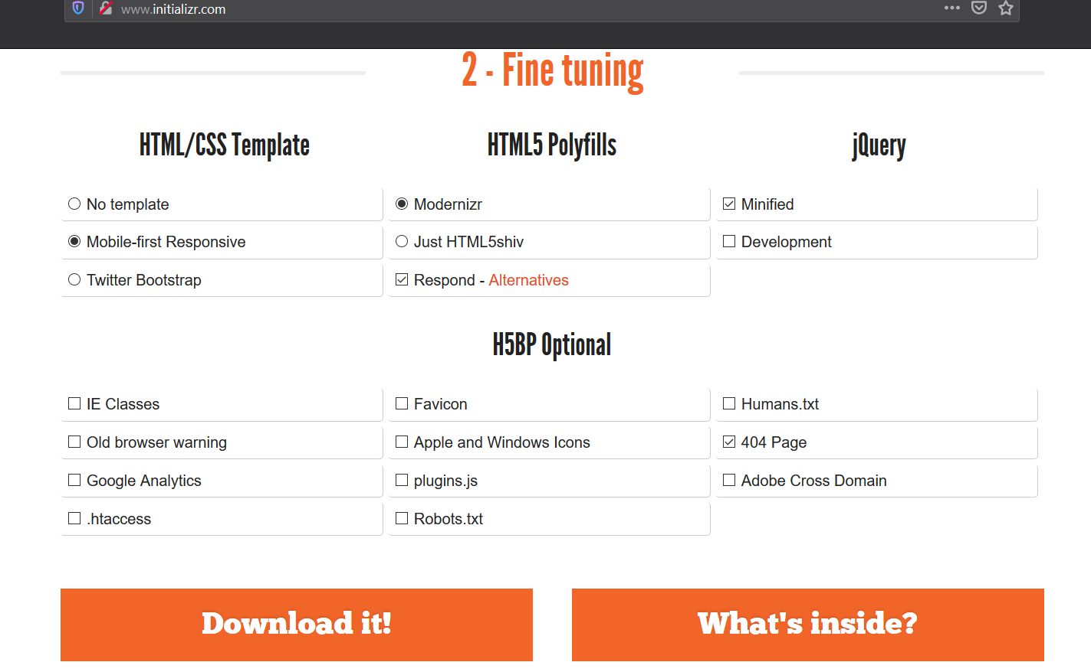
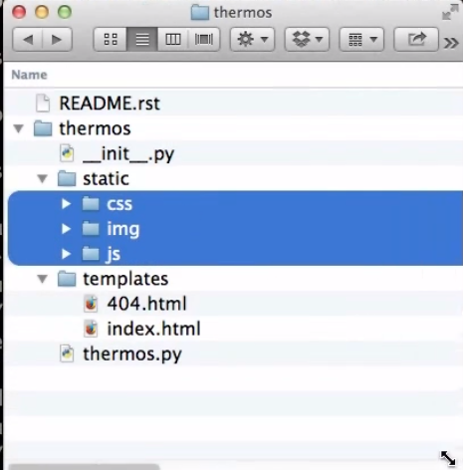

Slide 8
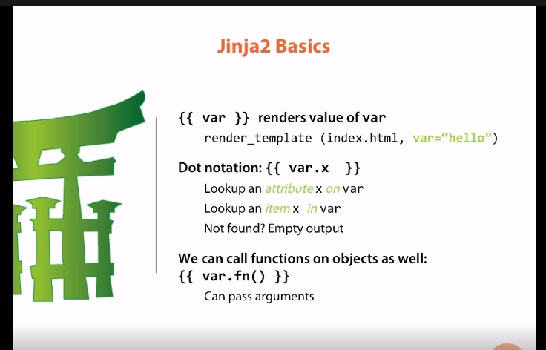
Jinja stuff
Jinja is a template engine, which can generate any text based file format e.g. HTML. Thus our html files are not html files but jinja templates
i.e. jinja tries to get attribute x of the object var, but if var is an object like a dict, the item/element
inside var will be returned
And finally if nothing is found, jinja will return an empty string

Slide 9
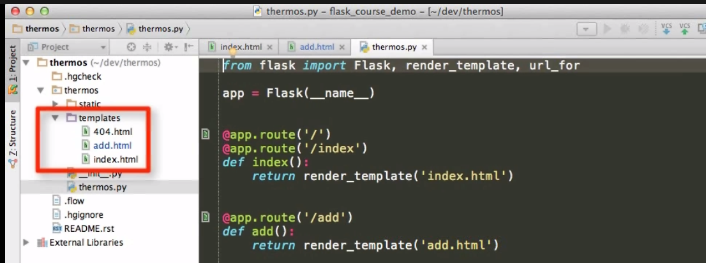
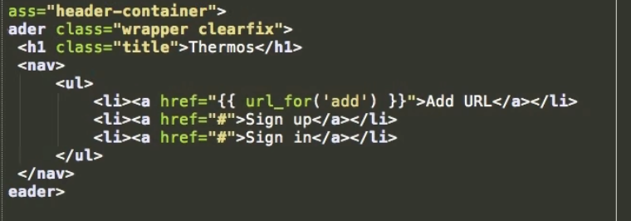
Render template looks by default in the templates folder.
render_template(file_name, args)
Jinja example
{{ }} activates jinja rendering and jinja now calls the url_for function, which has an argument an html link.
This html file is located inside the templates folder, in this case add.html

Slide 10
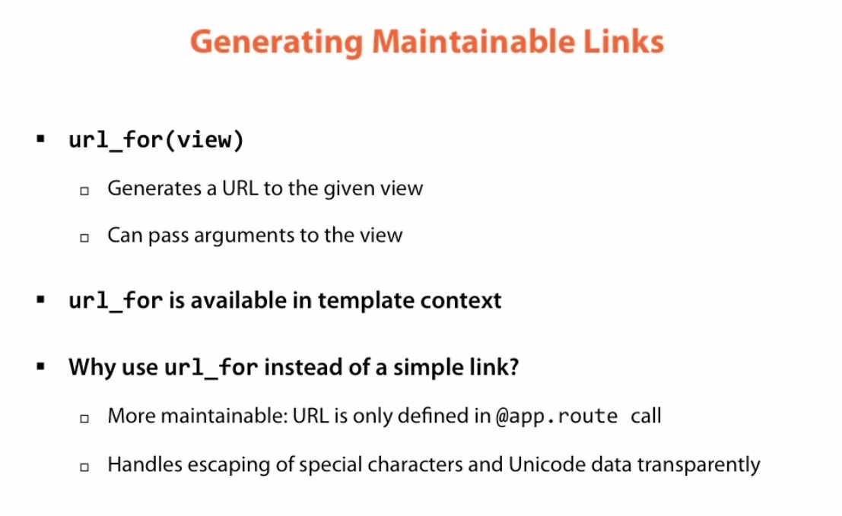

Slide 11
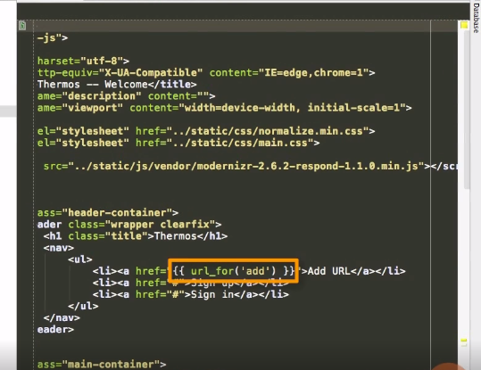
url_for is a jinja function available in all flask templates and takes the view passed in as the argument and returns its url
{{ }} double curly braces are used when we want to output the value from a variable or function to the HTML page

Slide 12
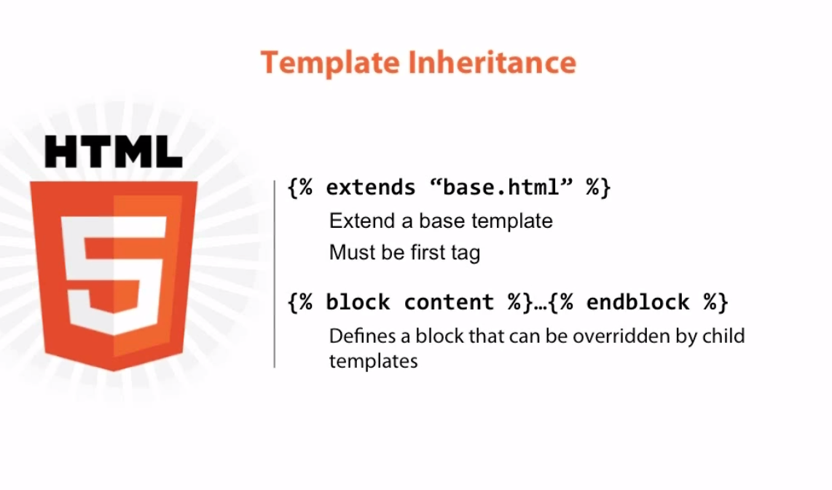
Overriding this template by the child template uses the same syntax
- With template inheritance, we define a parent template with blocks that can be overridden by its children
- And children define their parent template by using the extends expression
- {{ }} are for rendering values from variables and functions whereas all other expressions are { }

Slide 13
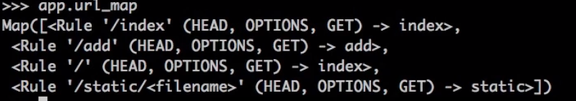
url_for can also be used to replace fixed links of static links in the html, so that if the app is to be deployed to the web or any other source, links can easily be changed from python = maintainable
endpoint
Any keyword argument that can be passed to the view function
url_for takes the reverse of the url_map, we know the endpoint static and now want to find the url attached to this = filename

Slide 14
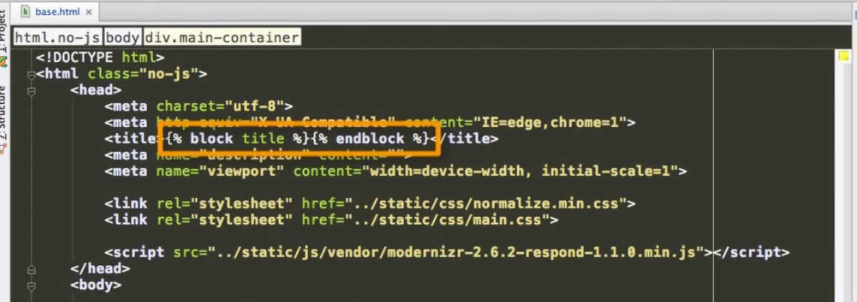
Template inheritance
All other logic like for loops and if-else statements go in curly braces + % sign = block.
Syntax:
{% block nameOfBlock %}{% endblock %} i.e. this block’s name is title

Slide 15
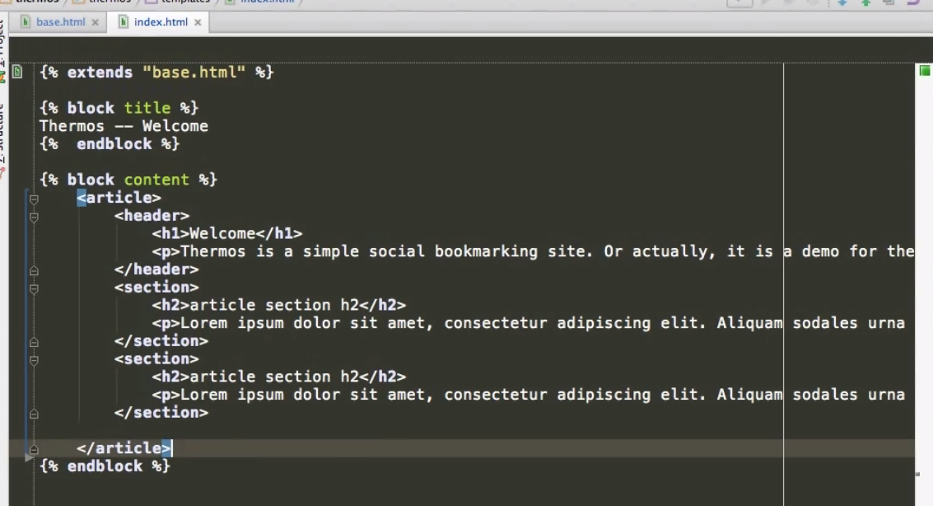
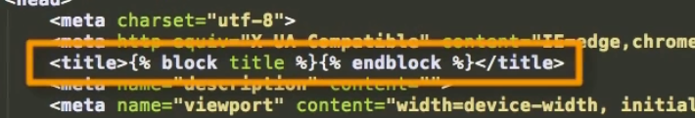
The block title in the base template will be replaced by jinja to the one in index.html i.e. Thermos – Welcome. Everything else will be copied/inherited from the base
By creating a base template page, all other pages now refer to this base.html page. Making other pages quite clean. Everything that is not marked as blocks is inherited from the parent

Slide 16
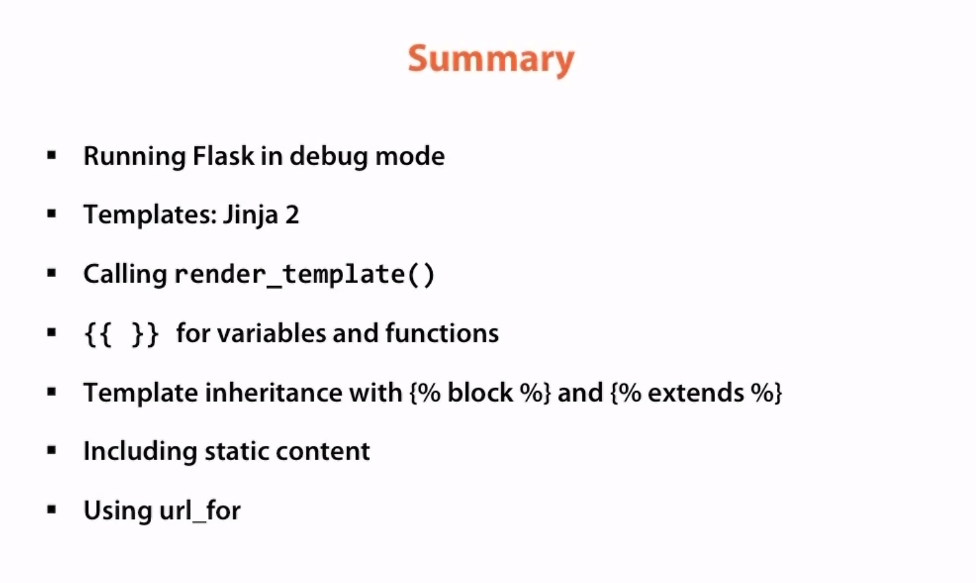

Slide 17
Forms and View Logic
Module 4

Slide 18
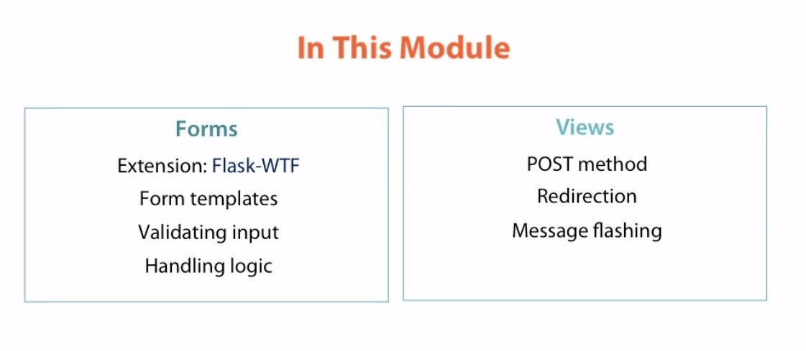

Slide 19
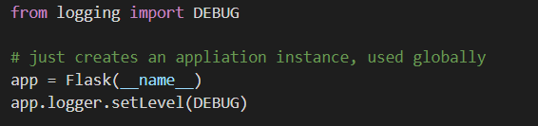
This sets the logging at the debug level, i.e. every action is displayed on the command line

Slide 20
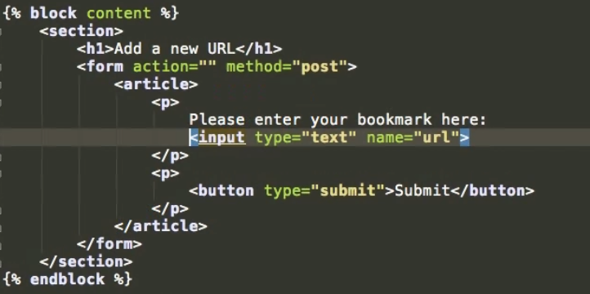
This allows the user to send (post) data to the server
Says that the name of the input post by the user is stored in the variable = url
The name attribute specifies the name of an <input> element.
The name attribute is used to reference elements in a JavaScript, or to reference form data after a form is submitted.

Slide 21
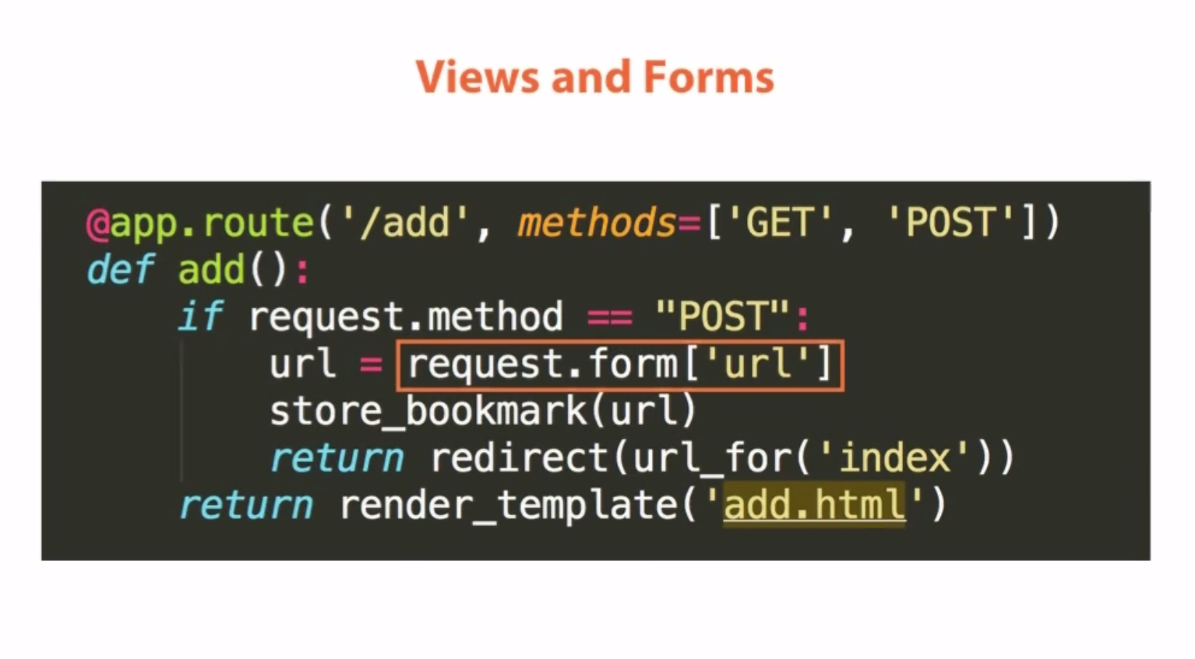
The default method is GET. But if posting then both methods need to be mentioned
Form is a dict that can be used to get the various inputs in the form. Here the input url is retreived
When this goes good, the user is redirected to the index page
The user is just viewing

Slide 22
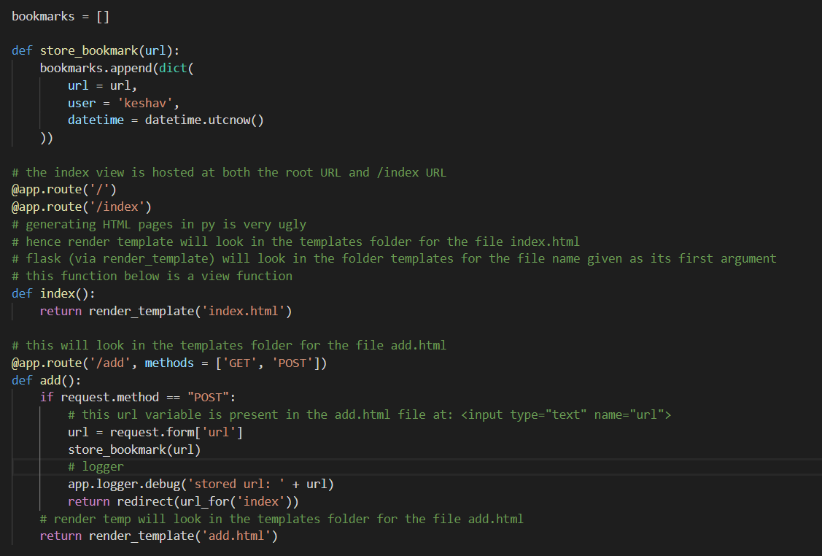
The variable url received by the post request form is added to a dictionary
Allows both posting and getting data
Asks for the text the user typed by asking the request for any form data with the name url
Sends user to another page after form has been submitted succesfuly
And by the url_for we avoid hardcoding urls (like jinja)
But if the request is GET i.e. the user is just viewing the form, then just keep showing the add.html page

Slide 23
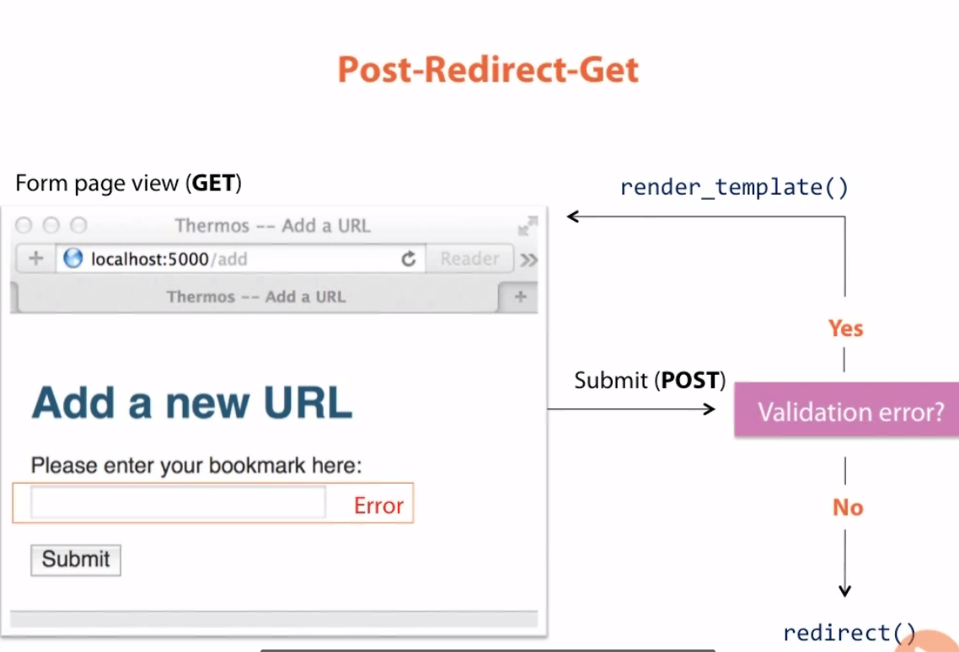

Slide 24
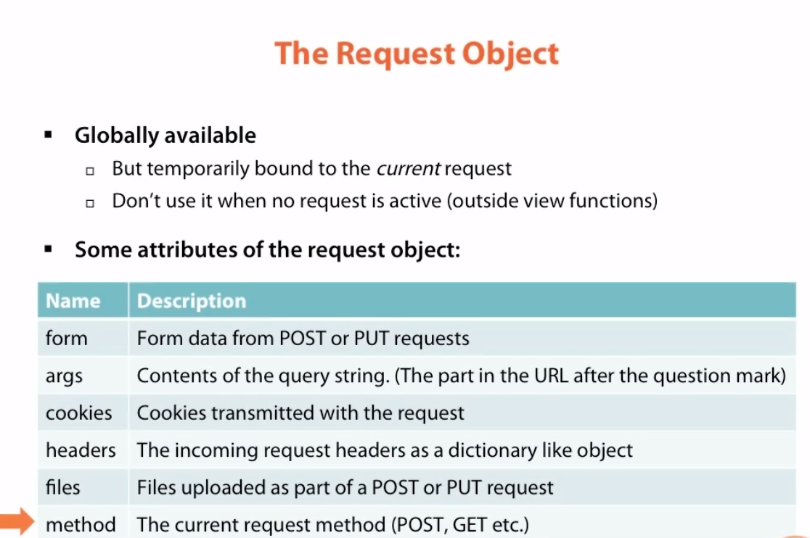
Form attribute gives access to the input data from an HTML form
Ignore for now

Slide 25
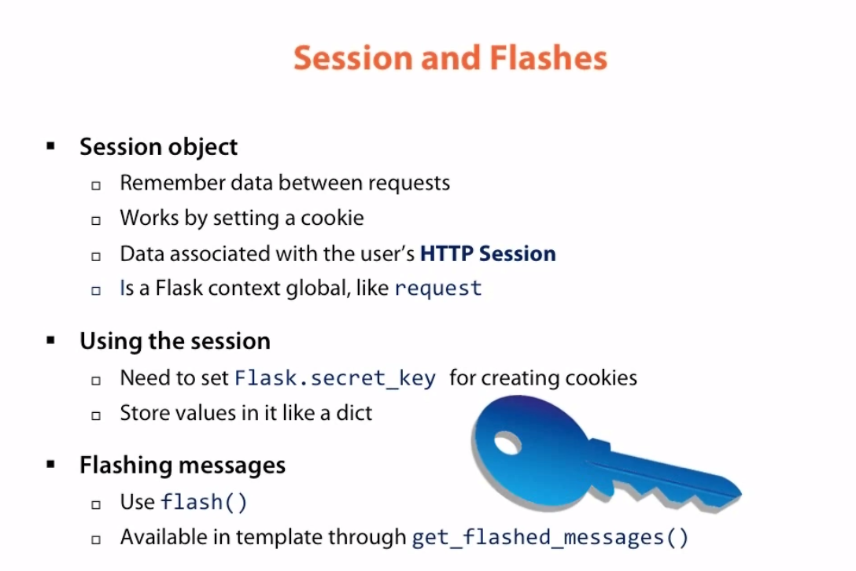
To show messages to the user with the flash function

Slide 26
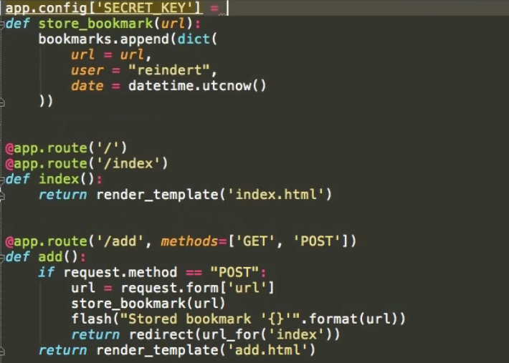
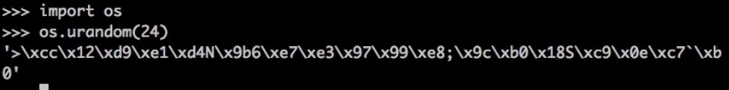
app.config is a dict that holds configuration keys, e.g. key: Secret_key
Enter a cryptographically generated key by:
:

Slide 27
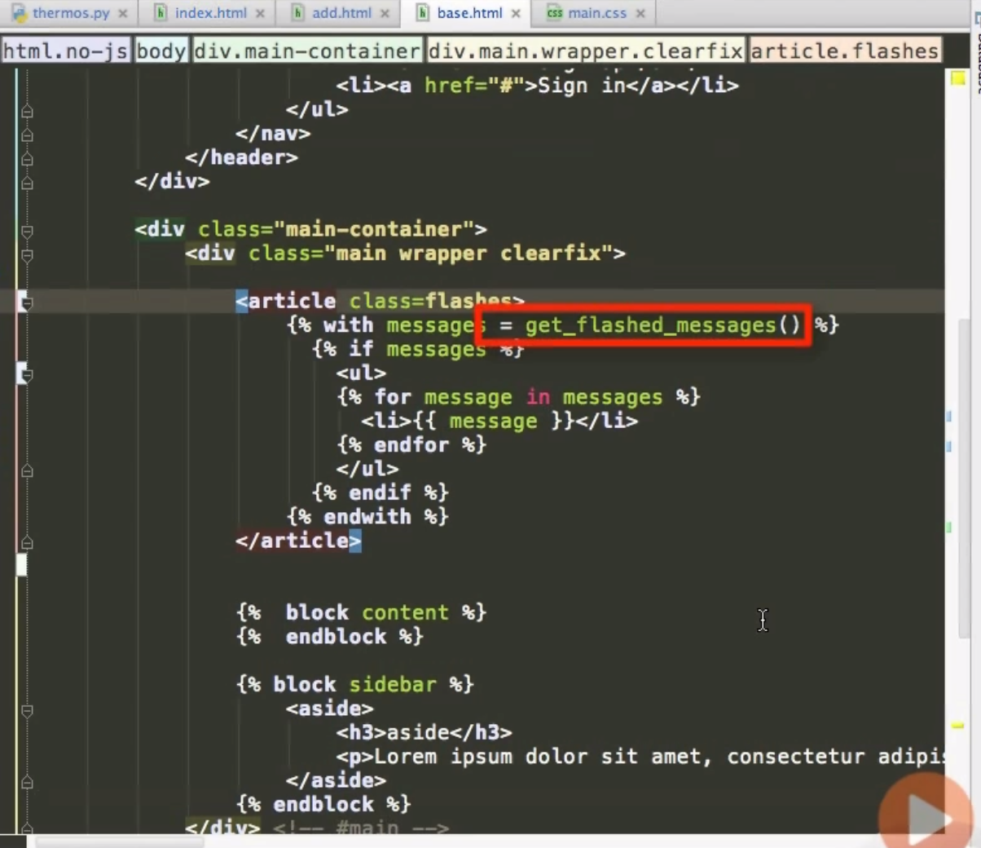
Using the flash function, to retrieve a list of messages from the function
Assigning this to a messages variable, the with implies this is valid for the duration of the with block only
This is a variable (and outputs smthg) hence it is in double curly braces {{ }}

Slide 28
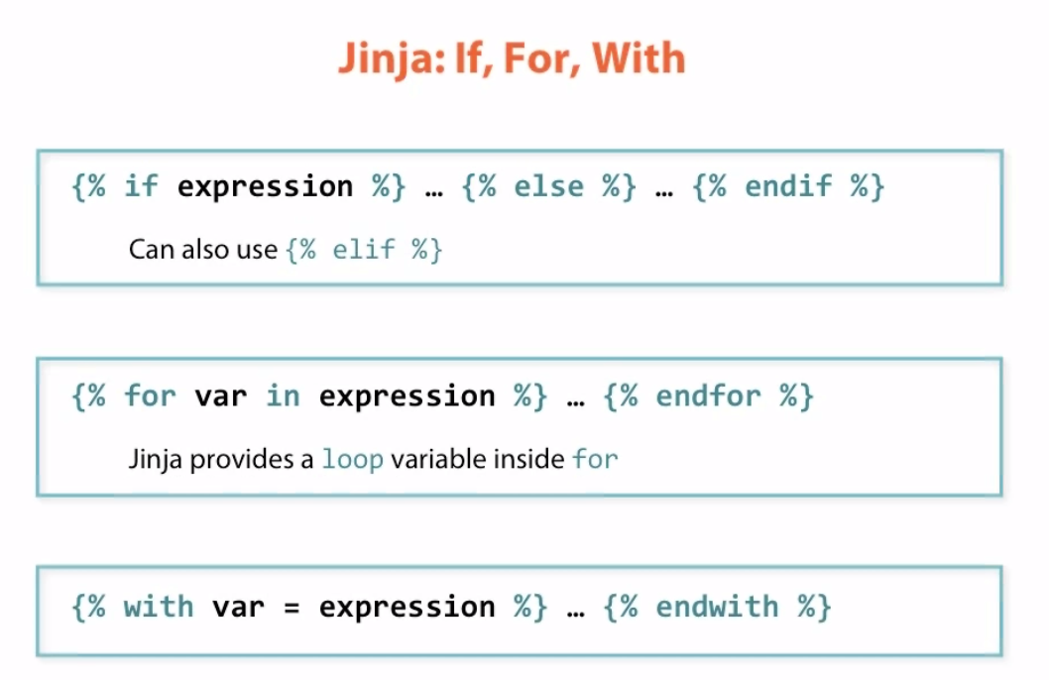
Remember to end with the endif, this is different than typical python syntax
Same, should end with endfor
Defines a variable to the duration of the block

Slide 29
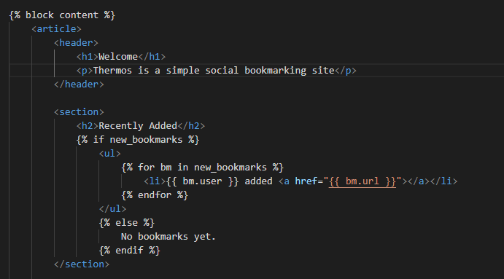
If this var exists
Running a for loop over the variable bm

Slide 30
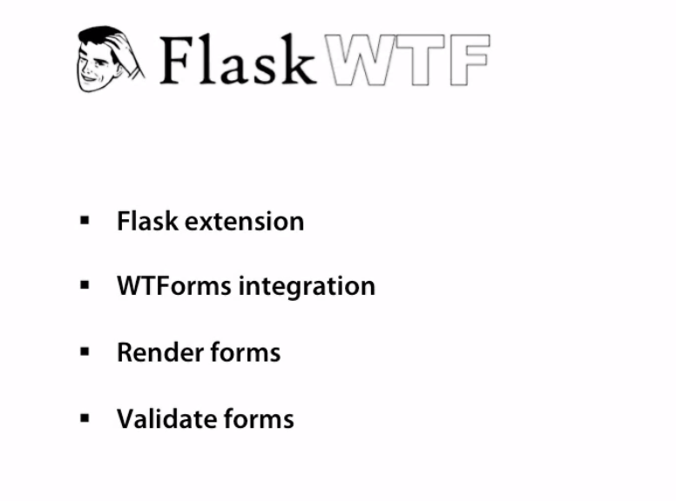

Slide 31
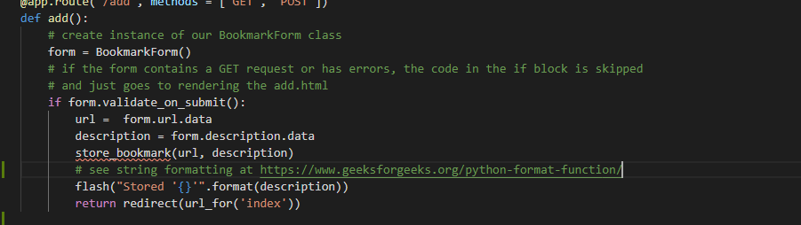

Slide 32
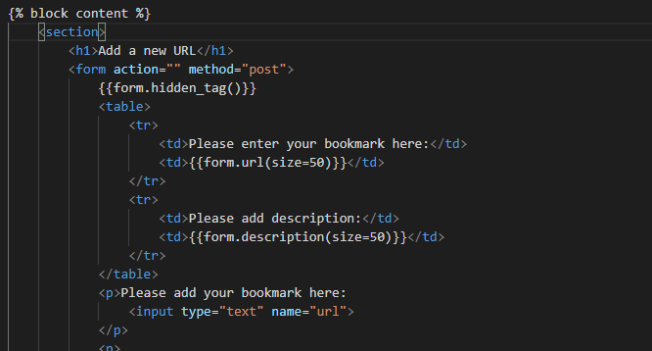
Needs to be included always to prevent CSRF = Forgery. If this is not included Flask-WTF will reject it
Jinja renders these as URLs
Tells this is a description and it’s size is 50 = html style

Slide 33
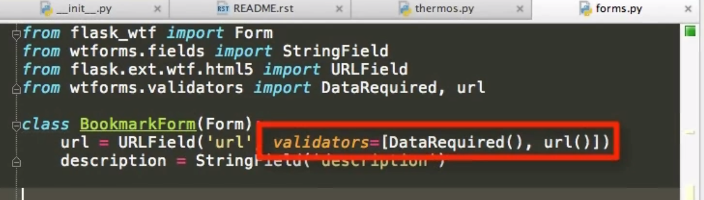
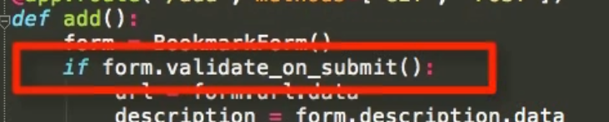
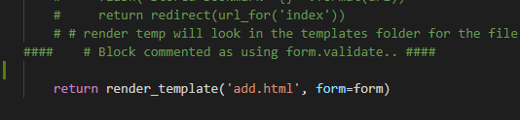
These validators check the input data for errors
DataRequired = this field has to be filled
If the data is a valid url
This will check if the form is get or has errors then it will skip the below code
form is passed to the template to generate it as html, we are rendering the template “add.html" with the form as context to the user

Slide 34
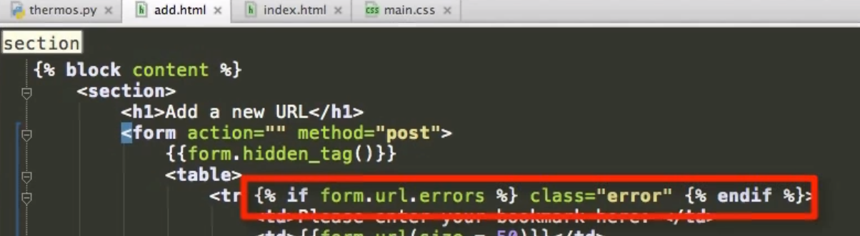
If the url form has errors then show the CSS class error. This enable the user to know which field caused the error

